Slide 1
Financing terrorism
As a broad rule in europe, africa and middle east terrorism use organized crime methods and processes to finance operations.
This practice rely upon their willingness to :
- increase and diversify their way of financing,
- improve their autonomy
develop activities in free of rules areas no rules
This approach focus on weaks states with lack of controls, porous borders and corruption.
In some case smuggling is organized by terrorist organization undercover of humanitarian NGO (ex-Yougoslavia, sahelian africa,..)

Slide 2
Financing terrorism
In 75 international legal inquiries focused on terrorism, use of cigarettes smuggling reach 20% of all financial criminal sources
From a global perpespective more than 15 terrorist organizations are using repeatedly cigarettes and drugs smuggling for financing : Pakistanese talibans ( TTP), Laskhar E Taiba (LeT) , Al Quaida au Maghreb (AQMI), Hezbollah, Hamas , Frac , PPK , ETA and IRA.
Terrorist organisations in african states as Mali, Niger or Lybia ask for tax payment on traffic passing through their controled area . This includes smuggling and traficking of cigarettes, drugs, weapons, food, oil, and migrants.

Slide 3
Financing Terrorism
(CAT 03/2015)
NORTH AMERICA
Mohammad Youssef Hammoud - Hezbollah (2001) North Carolina and Michigan cigarettes smuggling network financing Hezbollah in Lebanon. Hammoud has prepared murder of Prosecutor and an attack against the court. He was financing also in Vancouver canadian network leadered by logistic head of Hezbollah
Elias Mohamed Akdar – Hezbollah (2003 ) Networkk trafficking between and indian reserve and Michigan for Hezbollah. Was sending 500 $ monthly to Lebanon.
Ahmed Arel – Al Quaida (2004) Supply of 14000 $ to finance move to Afghanistan camps of 6 yemenis americans through cigarettes smuggling
Saifullah Anjun Ranjha- Al Quaida (2008) Money laundering and terrorism financing through drugs , cigarettes and weapons. between 2003 and 2007 2,2 millions $ have been moved to Al Quaida members through a « Hawala »
Basel Ramadan - Hamas and Hezbollah (2013) Cigarettes smuggling and trafficking in Virginia for 55 millions $ with 10 millions $ profit send partly to foreign states

Slide 4
Financing terrorism
(CAT 03/2015)
ASIA AND MIDDLE EAST
Pakistan , Talibans and Lashkar E taiba group (2010-2015) 15 to 20% budget of Waziristan terrorists groups is financed by forgery, counterfeit, and cigarettes smuggling
Abu Sayyaf (Philippinas ) and Jemaah Islamiyah (Indonesia) Both groups are known to use cigarets smuggling as a financing tool
Isis, Jamal al Nostra ( Syria ,Irak ) Isis has forbidden cigarettes smoking but smuggling is still an important activity through borders of Turquia and Kurdistan. In the area smugling of cigarets has been multiplied by 2, oil by 4 and mobile phones by 10

Slide 5
Financing terrorism
(CAT 03/2015)
EUROPE
Swiss for ETA – (2004) Cigarettes trafficking by a swiss residents group for ETA from Buchs free port. One billion euros has passed through swiss banks before to be sent to organization.
Fehti Al Haddad, Italy for GIA/GSPC/AQMI (1995-2002) Cigarettes trafficking around Napoles, Milano and Roma to finance algerian GIA
Rasim Delic , Bosnia Herzegovina (2007) Cigarettess smugling in Bosnia to finance Moudjahidin batallion
Amedy Couliblay Djamel Beghal , France (2010-2015) Cigarets and drugs trafficking to finance ISIS attacks on french territory and escape trial of Smaim Ait Ali Belkacem
France to Syria and Isis (2012-2016) Lot of djihadists have paid there trips to Turquia, Lybia or Syria through cigarettes and drugs trafficking

Slide 6
Financing terrorism
(CAT 03/2015)
EUROPE
Portugal, GSPC, AQMI (2006) Network linked with GSPC and AQMI using for logistic and financial purposes clandestine immigration , cigarettes smuggling and cars trafficking
Belgique, ETA (1970) Cigarettes smuggling through Antwerp to finance purchase of weapons for ETA
United Kingdom, IRA (2010) European inquiries investigation had brought to loght than 2 irishmen had built a huge trafic to import weapons and explosive in northern ireland financed by cigarets smuggling

Slide 7
Financing terrorism
(CAT 03/2015)
NORTH AFRICA AND SAHEL
Mokhtar Belmokhtar , Aqmi and Al Morabitoun (1990-2015) Khales Abou Al Abass « Mr Malboro » as leader of the groups has managed terrorist actions to In amenas, Bamako and Ouagadougou. Since 1990 he works with arabs smugglers of Tilemsi tribe and extend his territory to north Mali. He is trafficking on weapons, cigarets , cars and since 2008 on hostages business
Mujao, north Mali (2014-2016) Terrorist group created by cigarettes and oil smugglers with Algeria, Niger and Lybia

Slide 8
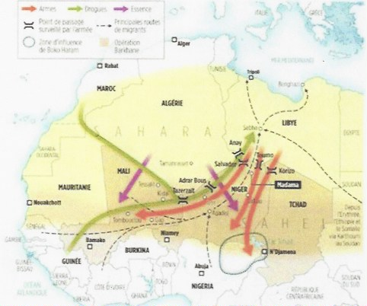
Financing Terrorism
Sahelian case

Slide 9
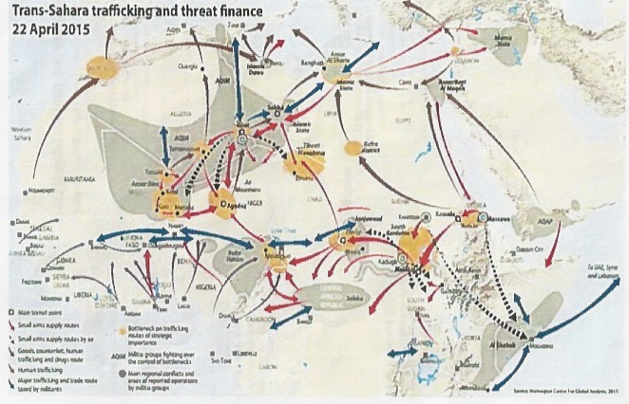
Trans sahara trafficking and threats finance
NCSA 22/04/15

